Slide 1
EURASIA:
European Studies Revitalized Across Asian Universities

Slide 2
Sofia University Team
Prof. Dr. Maria Stoicheva, Project manager (stoicheva@vice-rector.uni-sofia.bg)
Nikolay Yanev, PhD, Coordinator (n.yanev@phls.uni-sofia.bg)

Slide 3
Work packages and Project Tasks 2018 Work package 1 Preparation Work package 3 Development (Curricula) Work package 5 Quality Assurance Work package 6 Dissemination and exploitation Work package 7 Management

Slide 4
Project Timeline 2018
May 2018 EURASIA Launch event in Sofia
April - July 2018 Exploratory Visits in China and India
Web-site and online platform August 2018
Second project meeting Oct. 2018, Catania (IT)
First round of CH/IN faculty training in BG, IT, PL
Oct, Nov, Dec 2018
Nov, 2018 First project Interim report

Slide 5
WP 7 Management
Partner project team members (contacts, basecamp access)
Project Consortium meeting # 1 (kick-off meeting) in Sofia
Dates: 20-25 May, 2018, Sofia
Agenda:
May 21st - meetings with the EC in Bulgaria
May 22-24 - project team meetings
Practical information for meeting: travel, accommodation, visas…

Slide 6
WP 7 Management
Project consortium meeting #2 in Catania – October 2018 (review of project progress and planning upcoming tasks)
Consortium meeting will be combined with the first round of training visits of Indian and Chinese Faculty to the University of Catania
Dates: TBC

Slide 7
WP 1 Preparation: Exploratory visits
Meetings with the project team members of the partner University
Meetings with faculty, students, administration:
Discuss training needs, teaching capacities, topics for ES-related courses
Identification of faculty to be trained under EURASIA
Review of available courses on ES subjects; faculty specialization, student enrollment
Review of projects related to EU studies; bibliography
Compiling institution reports

Slide 8
WP 3 Development (Curricula)
WP Leader: University of Catania
Discussions among partners about the thematic scope of course modules, course syllabi, level of instruction (BA/MA/PhD), required readings, faculty expertise, etc.
Main subject areas: European Union institutions, EU International Relations & Cultural Diplomacy, EU Law and Legal Practice, EU-Asia Dialogue
Teaching methodology, student evaluation tools, extracurricular activities

Slide 9
WP 3 Development (Faculty training)
Faculty training
3 parallel visits with 3 groups of faculty from China and India to participate in 2-week trainings in Bulgaria, Poland, and Italy
Symbiosis: nominate and select faculty for the training visits
Online collaboration (through web platform: e-learning for students, e-resources for faculty and students)
Inter-university course on economic, political, and cultural dialogue between Europe and Asia
Validation & accreditation of new programs

Slide 10
WP 5 Dissemination and Exploitation
WP Co-leaders: Beijing Foreign Studies University and Jindal Global University
Draft Dissemination and Exploitation Plans with indicators
EURASIA Website
Dissemination conference in India (2019)
Dissemination conference in China (2020)
Summer school
Publications (books, articles)

Slide 11
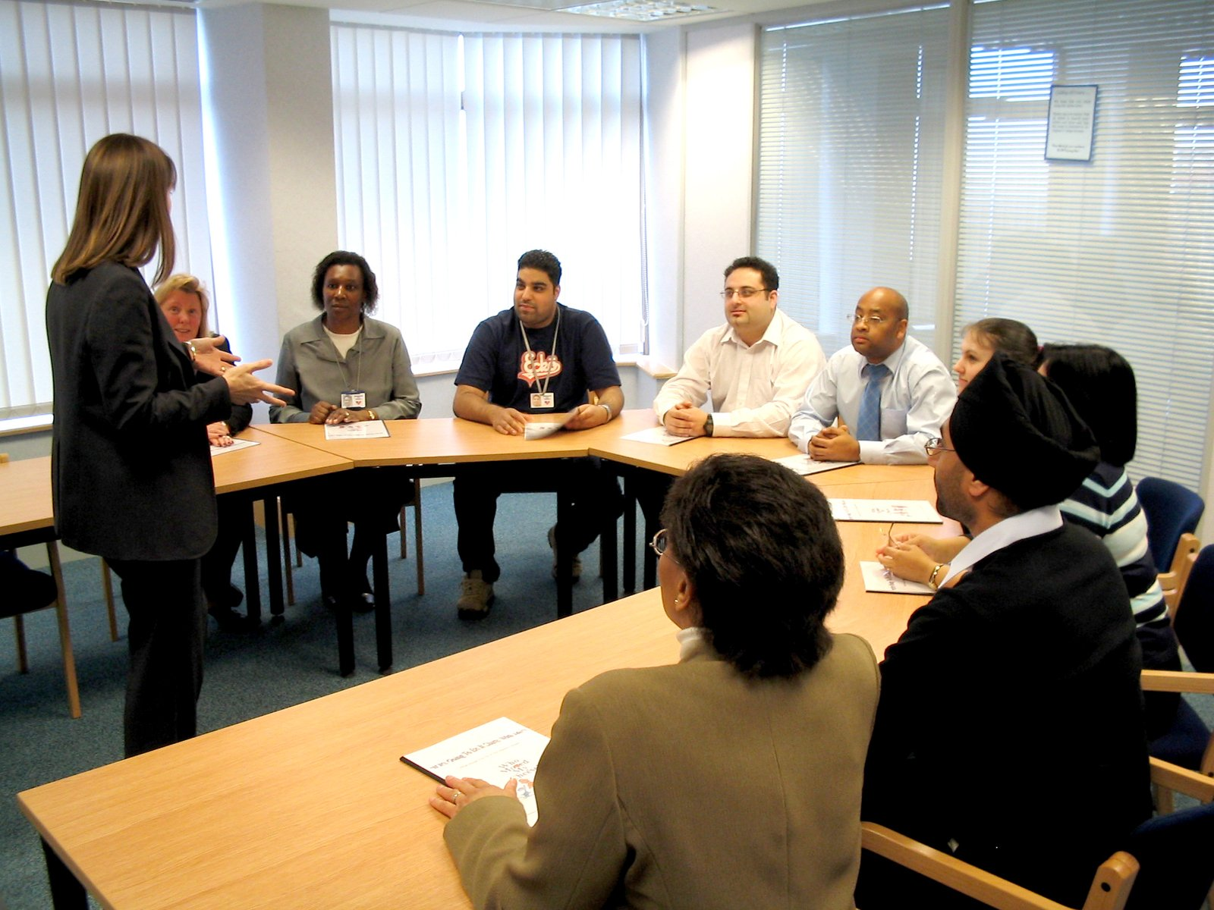
The Expected Results
New curricula
New pedagogical practices, learning tools and methods for professional development
Workshops, summer schools, conferences
Web platform and blended learning

Slide 12
Questions? Thank you for your attention !

